Slide 1
Comparison of various image restoration filters
Hardeep Singh
3089450

Slide 2
Content
Abstract
Introduction
Image degradation & restoration model
Various types of image noises
Various types of image restoration filters
Software and Hardware architecture
Code Diagrams
Experiments
Conclusion
Applications of Image restoration filters
Future work
References

Slide 3
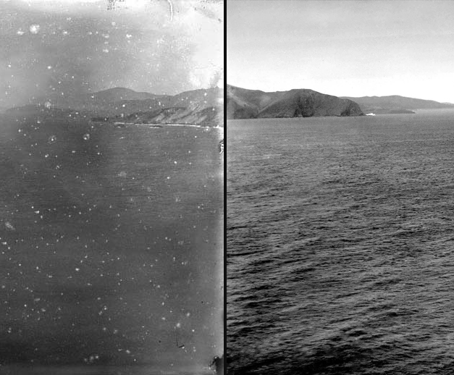
Image restoration
Image restoration is a process to take corrupt image as an input & than to provide enhanced or improved image as an output to the user.

Slide 4
Introduction
There are various factors which can degrade quality of the image.
Image can be corrupted due to image noises, motion blur or camera mis-focus. There are several image filters available to remove such kind of corruptness from images
Image noise is an electronic noise. In most of the cases, it doesn’t present in the original object images. It comes with the disparity of brightness or by the color details of given image.
It can basically be created from a scanner, sensor or a digital type of camera. Sometimes it is hard to avoid noise in an image.
In this paper, we will highly focus on Salt and Pepper noise, Speckle noise and Poisson noise. We will use mentioned noises to add distortion to the input image.

Slide 5
Introduction Contd…
The main target of Image Restoration is to remove all types of defects from the image which degraded image quality.
It is an inverse process of Image degradation & restores image quality.
There are various Image restoration techniques available in Digital Image Processing field.
Image filters like Wiener filter, Median filter, Inverse filter, Gaussian filter, Averaging filter etc. can be used for image restoration.
In this paper, we will focus on Adaptive & Optimal Wiener filter, Gaussian filter, Inverse filter & averaging filter. We will compare performances of all mentioned filters.

Slide 6
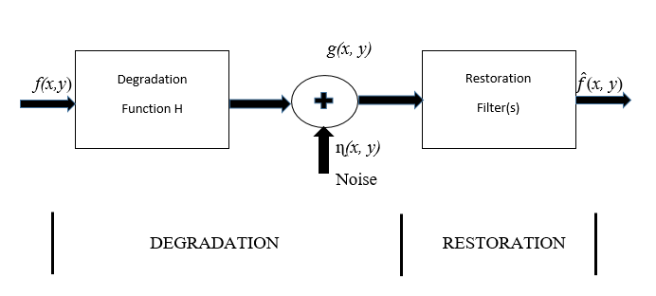
Image Degradation/ Restoration model
In the given model, degradation process is designed with degradation function that combined with an additive noise. After adding noise, it gives degraded image & feed it to restoration process. It takes input image f(x, y) to generate a degraded image g(x, y). Where H is degradation function. The degraded image is demonstrated in spatial domain by following function.

Slide 7
Various types of image noises
There are various types of additive noises present which leads to degradation of images.
Salt and Pepper Noise
Speckle Noise
Poisson Noise

Slide 8
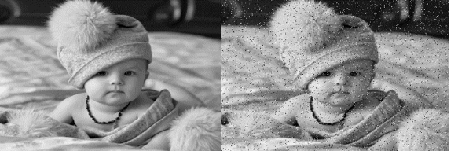
Salt and Pepper noise
It is also known as impulse noise, where impulse is referred to as intensity spikes in an image.
There are only 2 possible values, which are black & white dots present in an image.
It is basically caused by sharp and sudden changes in Image signals & errors in data transmission.
Other reasons of occurrence of this type noise are malfunctioning of pixels due to false memory locations and errors in digitization process of a camera.
The corrupted or distorted pixel values are set to minimum or maximum value which makes image pixels looks like ‘Salt & pepper’ present in it. [1].

Slide 9
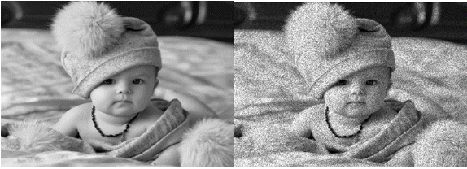
Speckle Noise
It is the noise which occurs due to the effect of environmental conditions on the imaging sensor during creation of images. [2]
Speckle noise frequently occurs in medical images like ultrasound images & x-rays image.
During creation of images from sensors, corrupted & uncorrupted pixels scattered all over the image which leads to creation of noise in generated image.

Slide 10
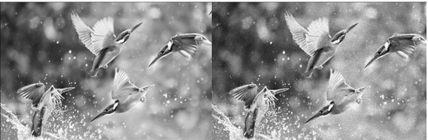
Poisson noise
Poisson noise is also known as shot noise. It is a type of electronic noise.
In electronics shot noise creates from discrete nature of electric charge.
It also generates in photon counting in optical devices, where it is attached with particle of nature. [3]

Slide 11
Various Image restoration filters
various Image restoration filters
Optimal Wiener filter
Adaptive Wiener filter
Median filter
Average filter

Slide 12
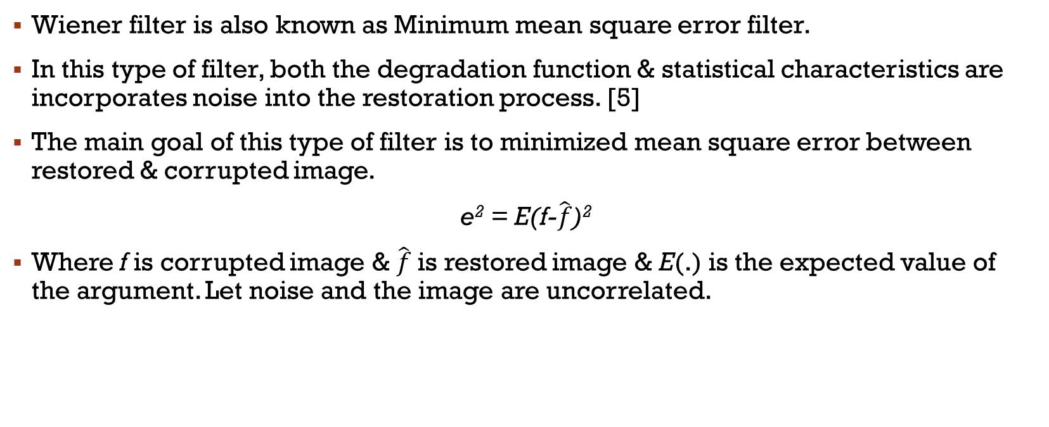
Wiener filter
Wiener filter is also known as Minimum mean square error filter.
In this type of filter, both the degradation function & statistical characteristics are incorporates noise into the restoration process. [5]
The main goal of this type of filter is to minimized mean square error between restored & corrupted image.
e² = E(f-$\hat{f}$)²
Where f is corrupted image & $\hat{f}$ is restored image & E(.) is the expected value of the argument. Let noise and the image are uncorrelated.

Slide 13
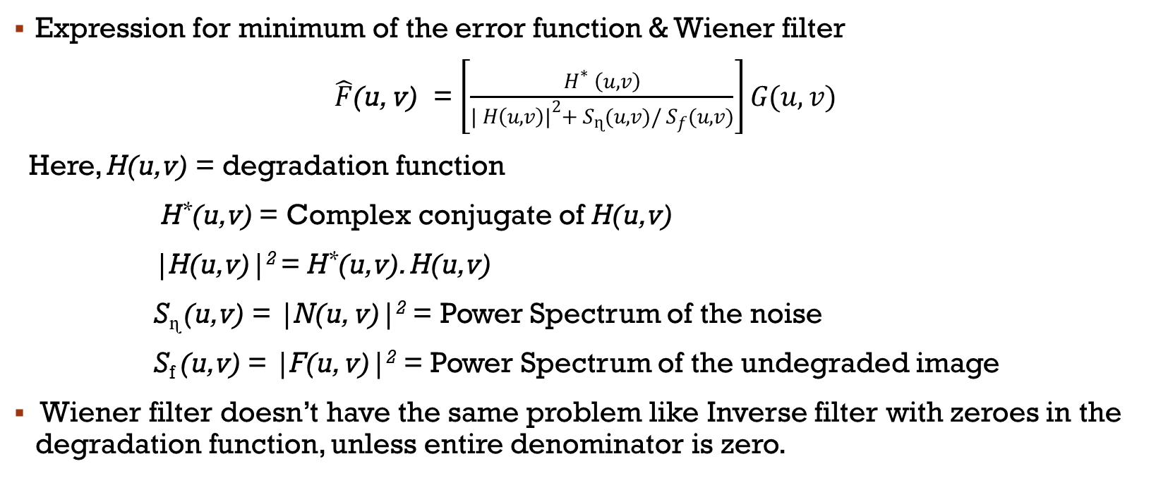
Wiener filter contd…
Expression for minimum of the error function & Wiener filter
$\hat{F}$(u, v) = $\left[\frac{H^{∗} \left(u, v\right)}{| H{\left(u,v\right)|}^{2}+ S_{ɳ}(u,v)/ S_{f}(u,v)}\right]G(u,v)$
Here, H(u,v) = degradation function
H*(u,v) = Complex conjugate of H(u,v)
|H(u,v)|² = H*(u,v). H(u,v)
S_{ɳ} (u,v) = |N(u, v)|² = Power Spectrum of the noise
S_{f} (u,v) = |F(u, v)|² = Power Spectrum of the undegraded image
Wiener filter doesn’t have the same problem like Inverse filter with zeroes in the degradation function, unless entire denominator is zero.

Slide 14
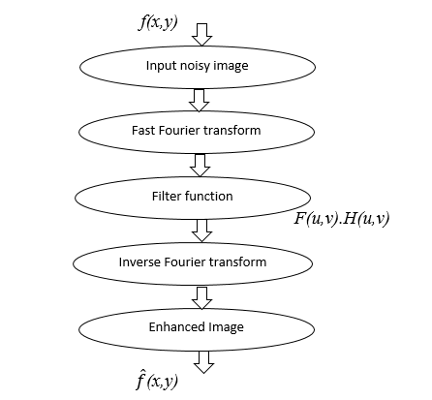
Flow chart
Flow chart of using FFT in frequency domain to write mat lab code

Slide 15
Adaptive wiener filter
It is a type of linear filter.
In this type of filter, Wiener filter can be applied adaptively.
It generates better results than basic Wiener filter. It preserves edges & high frequency parts of the images.
Adaptive Wiener filter performs great amount of image smoothing where variance is small between corrupted & restored image.
We have used Wiener2 function from Mat lab to implement it.

Slide 16
Median filter
Median filter is one of the powerful filter to remove Salt and pepper noise from the images.
It is very useful in removing noise from the corrupted image while preserving edges of the images.
The core criteria for this type of filter works as follows,:
window slides through whole of the corrupted image pixel by pixel & replace every pixel value with the median of its neighbouring pixels.
Mathematically, it is one of the simplest filter to understand & implement.
Neighbourhood size can be defined & overall it is known as window, which slides over all of the Image & change pixel values.
All the pixel values are calculated & then values are sorted. Once sorted, middle value of the window is replaced.
It is a slow filter.

Slide 17
Example
Suppose there is 6x6 input image. We will use 3x3 window size to replace one of the pixel value of given image.
We will replace circled pixel value with the median of the window 3x3.
Input window: 1, 4, 0,2,2,4,1,0,1
Sorted :- 0,0,1,1,1,2,2,4,4
Median of sorted input is 1.
1 | 4 | 0 | 2 | 3 | 5
2 | 2 | 4 | 6 | 0 | 4
1 | 0 | 1 | 3 | 5 | 4
6 | 0 | 3 | 2 | 4 | 3
5 | 6 | 0 | 1 | 6 | 4
2 | 0 | 1 | 2 | 3 | 3

Slide 18
Example contd….
Replace circled value from above matrix with calculated median 1
1 | 4 | 0 | 2 | 3 | 5
2 | 1 | 4 | 6 | 0 | 4
1 | 0 | 1 | 3 | 5 | 4
6 | 0 | 3 | 2 | 4 | 3
5 | 6 | 0 | 1 | 6 | 4
2 | 0 | 1 | 2 | 3 | 3
Output Image after replacing all pixel values with corresponding median values.
2 | 2 | 2 | 2 | 3 | 4
1 | 1 | 2 | 3 | 4 | 4
2 | 2 | 2 | 3 | 4 | 4
5 | 1 | 1 | 3 | 4 | 4
5 | 2 | 1 | 2 | 3 | 3
2 | 1 | 1 | 2 | 3 | 3

Slide 19
Average filter
Average filter is quite same like median filter.
It also used in image smoothing process & to remove different types of noises from the image.
In this filter, window size can be defined at the start of the image smoothing process.
After that, window slides over the image pixel by pixel & replace every pixel value with the average of the neighbouring pixels.
There is a disadvantage of this kind of filter.
When window moves to the edges of the image, all the edge pixel values are replaced with average neighborhood values which leads to blurry edge pixels.

Slide 20
Example
Consider input image of pixel 6x6. We will use window size of 3x3
In average Filter, values of border of the images remain unchanged.
Input window values: 1, 6, 0,6,2,4,1,0,1
Average of input values: round (1+6+0+6+2+4+1+0+1)/9 = 3
1 | 6 | 0 | 2 | 3 | 5
6 | 2 | 4 | 6 | 0 | 4
1 | 0 | 1 | 3 | 5 | 4
6 | 0 | 3 | 2 | 4 | 3
5 | 6 | 0 | 1 | 6 | 4
2 | 0 | 1 | 2 | 3 | 3

Slide 21
Example contd….
Replace circled value with the calculated Average =3
1 | 6 | 0 | 2 | 3 | 5
6 | 3 | 4 | 6 | 0 | 4
1 | 0 | 1 | 3 | 5 | 4
6 | 0 | 3 | 2 | 4 | 3
5 | 6 | 0 | 1 | 6 | 4
2 | 0 | 1 | 2 | 3 | 3
Output Image after replacing values with average of the window values.
1 | 6 | 0 | 2 | 3 | 5
6 | 3 | 3 | 3 | 4 | 4
1 | 3 | 3 | 4 | 4 | 4
6 | 3 | 2 | 3 | 4 | 3
5 | 3 | 2 | 3 | 4 | 4
2 | 0 | 1 | 2 | 3 | 3

Slide 22
System Specification
Hardware Architecture:
Processor used: Intel i5
RAM size : 4 GB
Software Architecture:
MATLAB R2017b

Slide 23
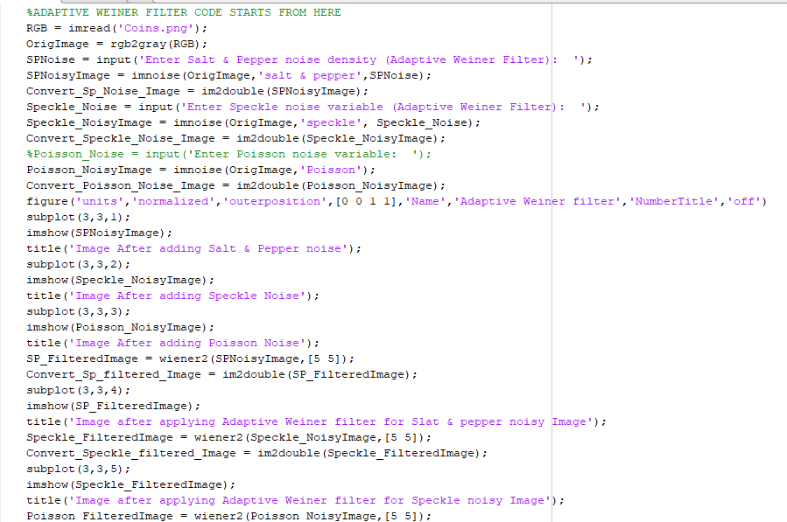
CODE diagram
Variable for Noise density
Function Wiener2

Slide 24
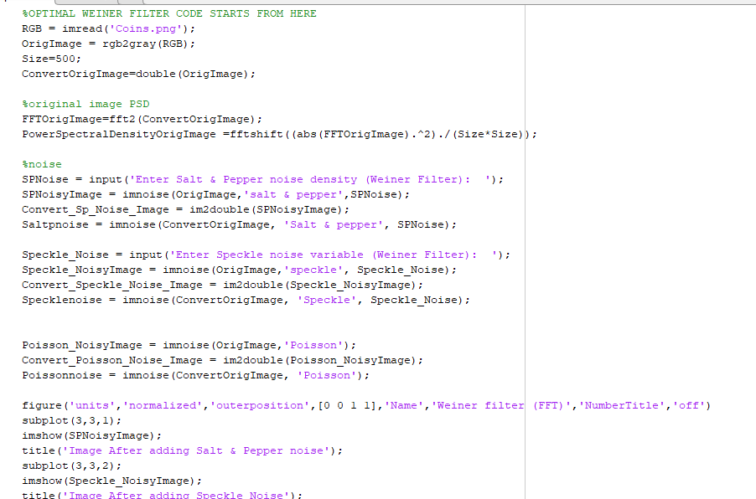
CODE diagram
Wiener Filter

Slide 25
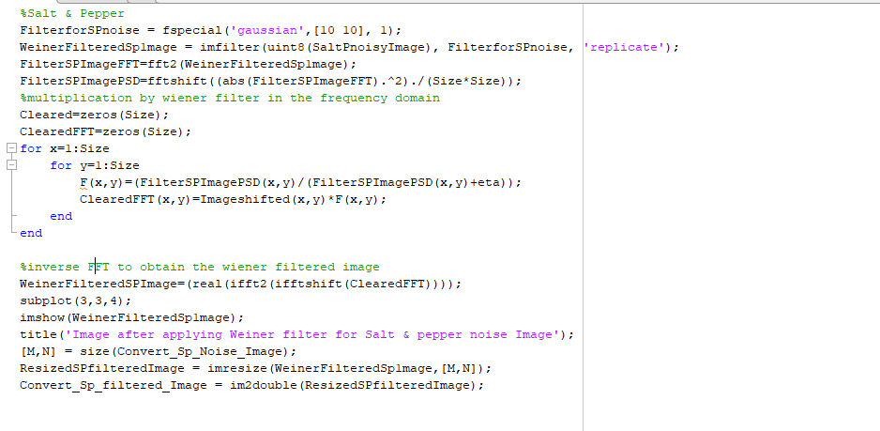
CODE diagram
Inverse Fast Fourier to get enhanced Image

Slide 26
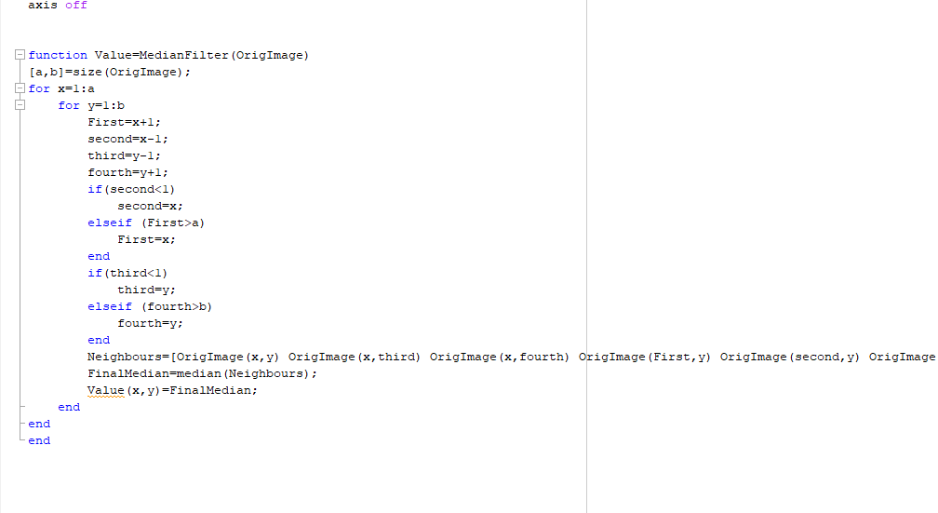
CODE diagram
Function for Median filter

Slide 27
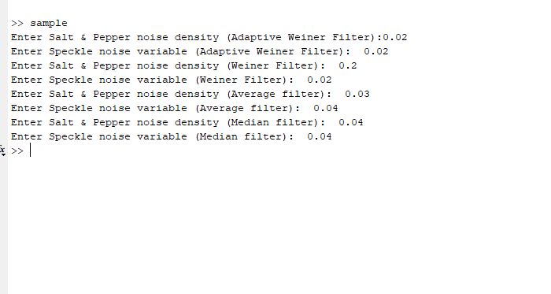
Code Diagram
Command window view

Slide 28
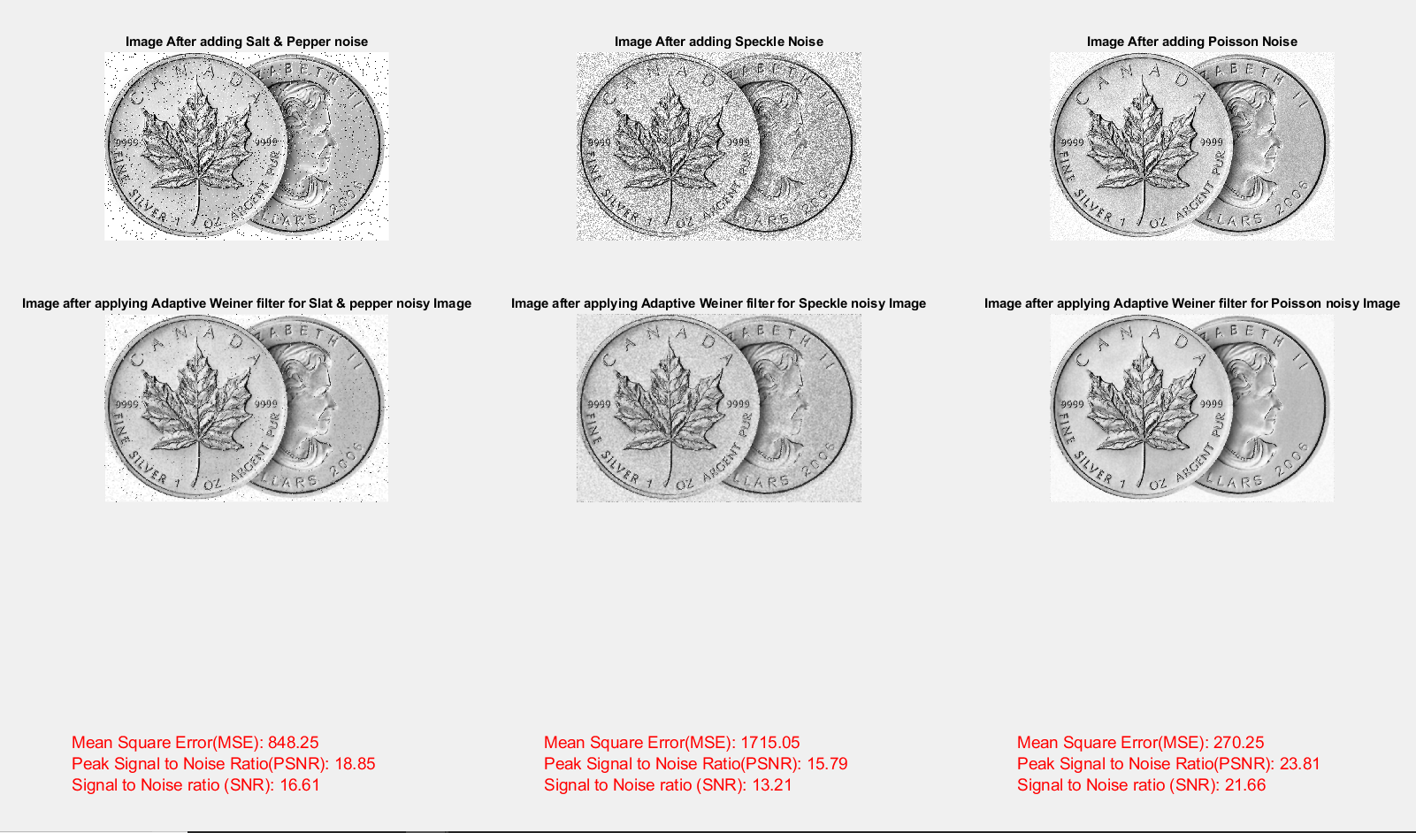
Experiment 1
Image Restoration with Adaptive Wiener filter
Density for salt & pepper noise = 0.05
Density for Speckle noise = 0.07

Slide 29
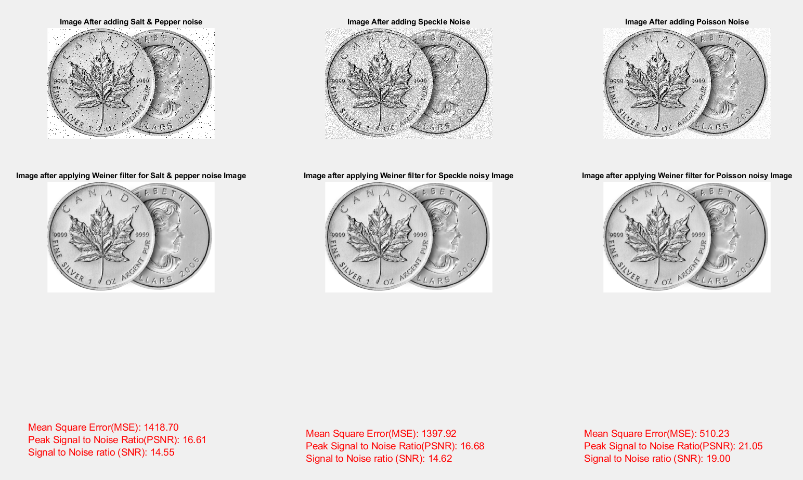
Experiment 2
Image Restoration with Optimal Wiener filter:
Density of Salt & Pepper noise: 0.04
Density of Speckle noise: 0.03

Slide 30
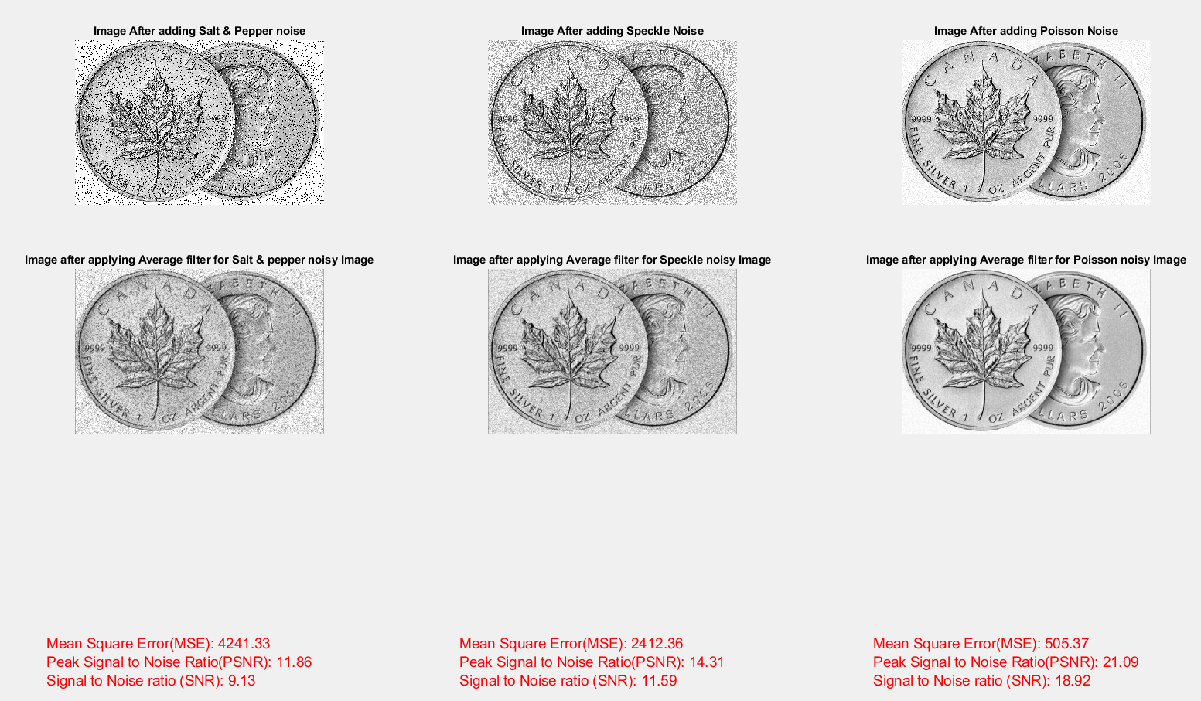
Experiment 3
Image restoration with Average filter:
Density of Salt & Pepper noise: 0.2
Density of Poisson noise: 0.1

Slide 31
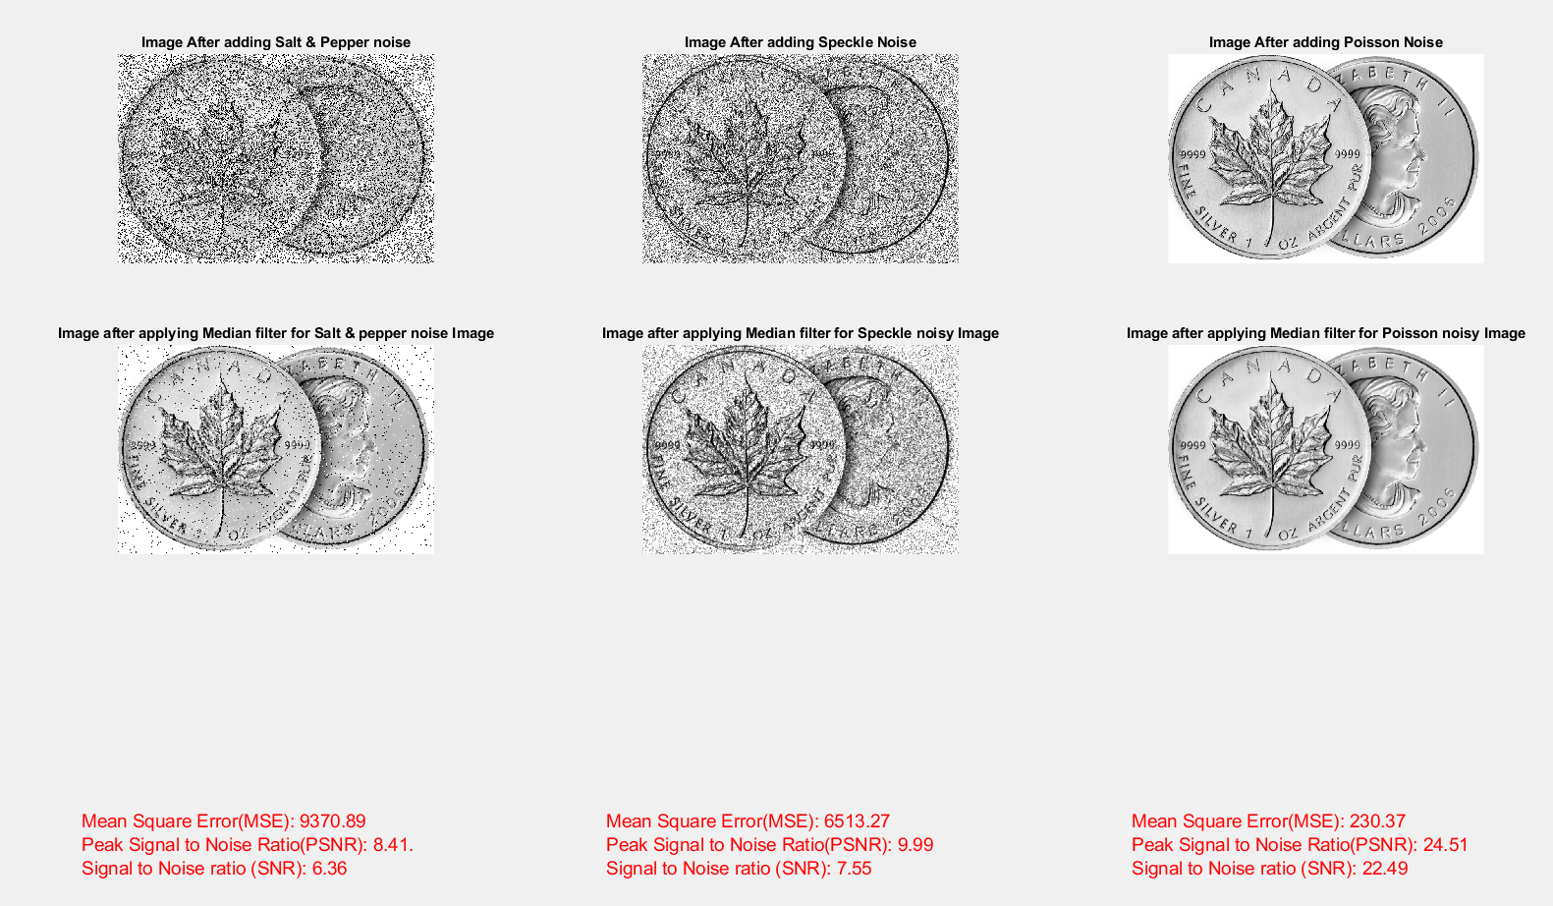
Experiment 4
Image Restoration with Median filter:
Density of Salt and pepper noise: 0.4
Density of Speckle noise: 0.3

Slide 32
Comparison Table for Salt & Pepper Noise
 | Noise Density =0.03 | Noise Density =0.05 | Noise Density =0.07 | Noise Density =0.1 | Noise Density =0.3
Adaptive Wiener Filter | MSE = 544.81 PSNR= 20.77 SNR= 18.59 | MSE =852.60 PSNR=18.82 SNR=16.58 | MSE =1157.10 PSNR=17.50 SNR=15.19 | MSE = 1611.65 PSNR=16.06 SNR=13.65 | MSE =4932.23 PSNR=11.20 SNR=8.11
Wiener Filter | MSE = 1178.06 PSNR=17.42 SNR= 15.36 | MSE = 1646.43 PSNR=15.97 SNR=13.91 | MSE = 2094.77 PSNR=14.92 SNR=12.86 | MSE =2750.82 PSNR=13.74 SNR=11.68 | MSE =7267.90 PSNR=9.52 SNR=7.45
Average Filter | MSE = 972.37 PSNR=18.25 SNR= 16.06 | MSE =1373.39 PSNR=16.75 SNR=14.50 | MSE = 1774.54 PSNR=15.64 SNR=13.32 | MSE =2359.57 PSNR=14.40 SNR=11.99 | MSE =5935.44 PSNR=10.40 SNR=7.35
Median Filter | MSE =906.68 PSNR=18.56 SNR=16.54 | MSE =1365.95 PSNR=16.78 SNR=14.76 | MSE = 1836.52 PSNR=15.49 SNR=13.48 | MSE =2499.29 PSNR=14.15 SNR=12.14 | MSE = 7071.42 PSNR=9.64 SNR=7.61
Salt & Pepper Noise

Slide 33
Comparison Table for Speckle Noise
 | Noise Density =0.03 | Noise Density =0.05 | Noise Density =0.07 | Noise Density =0.1 | Noise Density =0.3
Adaptive Wiener Filter | MSE = 893.08 PSNR=18.62 SNR=16.28 | MSE = 1330.59 PSNR=16.89 SNR=14.42 | MSE =1721.03 PSNR=15.77 SNR=13.19 | MSE = 2251.47 PSNR=14.61 SNR=11.87 | MSE =5154.95 PSNR=11.01 SNR=7.46
Wiener Filter | MSE = 1397.52 PSNR=16.68 SNR= 14.62 | MSE =1909.61 PSNR=15.32 SNR=13.26 | MSE =2396.86 PSNR=14.33 SNR=12.28 | MSE = 3093.22 PSNR=13.23 SNR=11.17 | MSE =7386.74 PSNR=9.45 SNR=7.38
Average Filter | MSE = 1102.99 PSNR= 17.71 SNR=15.35 | MSE =1516.79 PSNR=16.32 SNR=13.85 | MSE =1896.33 PSNR=15.35 SNR=12.78 | MSE =2414.56 PSNR=14.30 SNR=11.59 | MSE =5494.16 PSNR=10.73 SNR=7.24
Median Filter | MSE =1080.51 PSNR=17.79 SNR=15.63 | MSE =1568.54 PSNR=16.18 SNR=13.98 | MSE = 2021.78 PSNR=15.07 SNR=12.85 | MSE = 2671.87 PSNR=13.86 SNR=11.59 | MSE =6498.02 PSNR=10.00 SNR=7.56
Speckle Noise

Slide 34
Comparison Table for Poisson Noise
 | Poisson Noise
Adaptive Wiener filter | MSE=269.97 PSNR=23.82 SNR=21.67
Wiener Filter | MSE=510.00 PSNR=21.06 SNR=19.00
Average Filter | MSE= 505.27 PSNR=21.10 SNR=18.92
Median Filter | MSE= 230.37 PSNR=24.51 SNR= 22.49
Poisson Noise

Slide 35
Conclusion
The Mean Square Error (MSE) is the cumulative squared error between the corrupted and the enhanced image, whereas Peak Signal to Noise Ratio (PSNR) & Signal to Noise Ratio (SNR) is a measure of the peak error.
Comparison results for different filters depicts that MSE error with Adaptive Wiener filter is lower than Wiener filter, Median filter & Average filter.
Whereas, SNR & PSNR is higher with Adaptive Wiener filter.
Which Shows that image filtered through Wiener filter have less error/ Distortion & noise in it.
Where higher values of PSNR & SNR indicates higher quality of image.

Slide 36
Conclusion contd…..
As a contribution in this project, we tried to implement wiener filter in Mat lab by using fast Fourier transformation of an image.
Than we try to use a filter function for image smoothing.
At the end, we tried to get enhanced image with inverse Fourier transformation.
Moreover, we tried to put 3 types of noises & 4 types of filters into 1 Mat lab code.
After comparing all 4 types of filters on different types of noises we found that Adaptive Wiener filter is best among all 4 discussed filter for Image restoration.

Slide 37
Applications of image restoration filters
Image restoration filters are used widely in the area of astronomy. Where sometimes images are taken from fast moving spacecraft’s which leads to degradation of images. Images restoration filters are used to restore these degraded image.[4]
Image Restoration filters are used to remove Poisson noise from the chest X-rays. Which leads to display clear image in X-rays.
Image restoration filters are also used to restore degraded images due to various reasons such as motion blur, various types of noises & Camera mis-focus

Slide 38
Future work
Currently, user have to add Noise density from Mat lab command window for every type of filter discuss in this paper.
Developer can improve lot of things in this project in future. Graphic User interface can be introduced where user will be able to run whole program at once.
After that from appeared screen, user will be able to select the any kind of Image degradation noise from dropdown list.
After selecting any noise, user will be able to add density of noise to test. Moreover, Buttons can be introduced to each type of filter.
By selecting any filter, it will be applied to noisy image. At the end, it will give Enhanced image.
Moreover, other types of image degradation noise & blur functions can be used. In addition, other filters can also be used to compare results.

Slide 39
References
[1] https://en.wikipedia.org/wiki/Salt-and-pepper_noise
[2] A comparative study in approaches to speckle Noise reduction in images, Alenrex Maity, Anshuman Pattanaik, Santwana Sagnika & Santosh Pani
[3] Wikipedia.org/wiki/Shot_noise
[4] Image Restoration and the various restoration techniques used in the field of digital image processing. Ishfaq Bashir, Adil Majeed, Owais Khursheed, June 2017
[5] Digital Image Processing, Rafael C. Gonzalez & Richard E. Woods (book)
[6] Image Restoration Techniques: A Survey. Monika Maru, M.C Parikh International Journal of Computer Applications (0975 – 8887) Volume 160 – No 6, February 2017
[7] A Survey on Image Restoration by Comparing the Different Deblurring Process and Filtration Navpreet Kaur1 , Varun Sanduja, Volume 4, Issue 6, Ver. II (Nov - Dec. 2014), PP 56-61
[8] Introduction to image restoration and comparison of various methods of image restoration 1Vaimin Raval,2 Prof.Lokesh Gagnani, International Journal of Advanced Research in Computer Engineering & Technology (IJARCET) Volume 1, Issue 10, December 2012

Slide 40
Thank you
.

